Slide 1

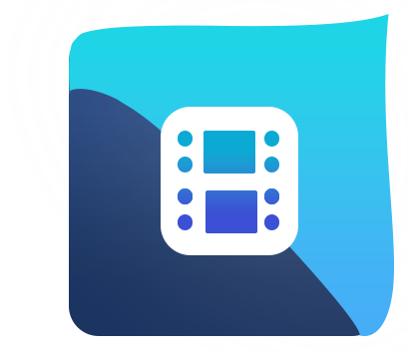
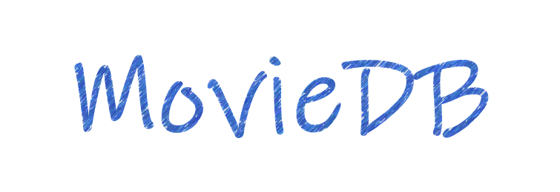
MovieDB – An alternative web app
experience for movie feeds

Slide 2
Purpose and Vision 🎯
Why MovieDB?
MovieDB aims to merge the functionality of a traditional movie database with the interactivity of a social platform. It’s designed to give users not only information about movies but also a space to express opinions, share experiences, and connect with others who share the same passion for cinema.

Slide 3



MovieDB - Key Features 🌟
Login / Sign Up: Create a personal account and securely log in to access all features. Includes a “Forgot Password” option to easily recover access if needed.
Cookie Consent: A cookie notification popup ensures compliance and provides the best navigation experience across the site.
Movie Categories: Movies are organized into various story-based categories, helping users explore films by genre or theme.
General Categories: Discover movies by popularity and rating, browse through Popular, Top Rated, and New Releases sections.

Slide 4




MovieDB - Key Features 🌟
User Reactions: Users can mark movies as favorites, rate them, or add them to their watchlist for later viewing.
Profile Overview: A personalized page displaying all your activity, including ratings, favorites, and watchlisted movies, giving you a complete snapshot of your movie interactions.
Settings: A dedicated page where users can update their account information, including username and password.
Feed: A dynamic social space where users can comment on movies, view discussions, and interact with other users. It brings a community-driven experience to the platform, allowing everyone to share opinions, exchange thoughts, and respond directly to others’ comments.

Slide 5
Figma Mockups 🎨
At the link below, you can explore the Figma mockups showcasing the UI/UX design of MovieDB. They highlight the app’s clean layout, intuitive navigation, and interactive user experience.
Each screen was thoughtfully crafted to represent the core vision of MovieDB, a modern, social, and user-friendly platform for movie discovery and engagement.
https://track-steep-68520881.figma.site/

